Slide 1
CS5112: Algorithms and Data Structures for Applications
Minimum spanning trees
Ramin Zabih
Sources: Wikipedia; Kevin Wayne, Kleinberg/Tardos

Slide 2
Administrivia
Prelim (midterm) date: Wednesday October 16
In class, closed book
Review session in class on October 7
Web site is: https://cornelltech.github.io/CS5112-F19/
HW1 is out, due by 10/7
Working in groups is important!
Q3 will be out Thursday, due in 24 hours
Lectures will be recorded “Real Soon Now”

Slide 3
Lecture Outline
RB tree example video here
Graphs, DAG’s, trees
Minimum spanning tree (MST)
Three simple MST algorithms
Proofs of correctness
Implementation notes

Slide 4
Trees, DAGs, graphs
Most general case: directed graph
Undirected graph: directed edges in both directions
DAG: Directed acyclic graph
Most ‘tree like’ graph
Tree

Slide 5
From graphs to trees
Often useful to find a tree inside a graph
Subset of the nodes and edges
Almost always cover all nodes, but just some edges
Why do we need to omit some edges?
Example: graph traversal via DFS/BFS
Sometimes you want to find a tree that is optimal
Most definitions of optimal are intractable
I.e., require exhaustive search

Slide 6
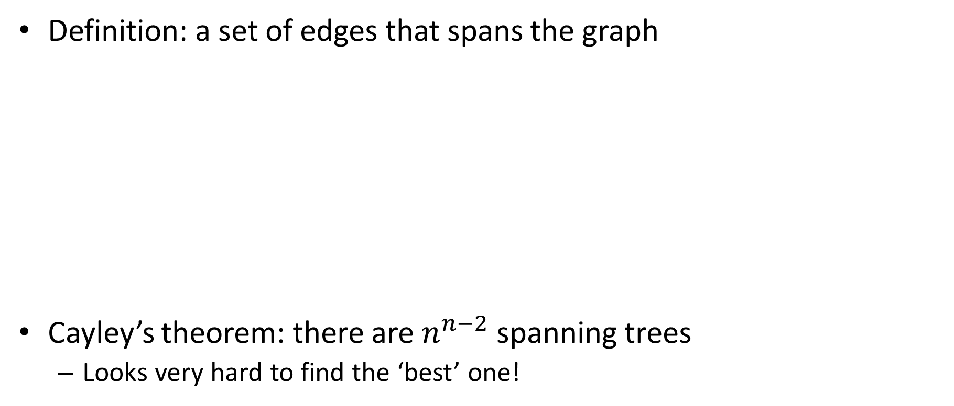
Spanning trees
Definition: a set of edges that spans the graph
Cayley’s theorem: there are $n^{n−2}$ spanning trees
Looks very hard to find the ‘best’ one!

Slide 7
Minimum spanning tree (MST)
Simplifying assumption: all edge costs distinct
MST: spanning tree with smallest cost
Digression: Steiner tree problem in graphs
Given an undirected graph with non-negative edge weights and a subset of vertices, usually referred to as terminals
Find a tree of minimum weight that contains all terminals (but may include additional vertices)

Slide 8
MST applications
Obvious: network connectivity
Old fashioned ‘emergency notification’ network
Non-obvious:
Traveling salesman problem
Very cool application
Image segmentation
See: Greg’s lecture on Union-Find

Slide 9
Basic MST algorithms
Prim: start with a root note and greedily grow a tree outwards, always adding cheapest edge at tree fringe
Kruskal: start with an empty tree, insert edges cheapest first, unless the edge would create a cycle
Nice Kruskal visualization
Reverse-delete: start with full graph, delete edges most expensive first, unless the edge would disconnect the tree

Slide 10

Cut property
Let $S$be any subset of nodes and let $e$be the min cost edge with exactly one endpoint in $S$.
Then the MST must contain $e$. Why?
We will see that this is not trivial

Slide 11

Cycle property
Let $C$be any cycle and $f$the max cost edge belonging to $C$.
Then the MST must not contain $f$. Why?

Slide 12
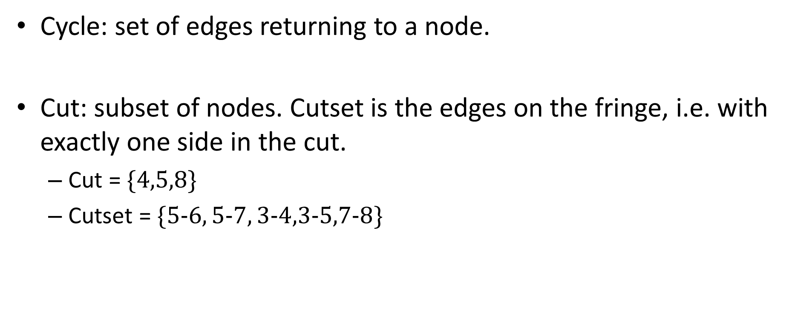
Cycles, cuts, cutsets
Cycle: set of edges returning to a node.
Cut: subset of nodes. Cutset is the edges on the fringe, i.e. with exactly one side in the cut.
Cut = $\{4,5,8\}$
Cutset = $\{5−6, 5−7, 3−4,3−5,7−8\}$

Slide 13
Cycle-cutset intersection
A cycle and a cutset intersect at an even number of edges
Why?
Cycle must leave and enter the cut same number of times
Corollary: can’t have a lone edge in both cycle and cutset

Slide 14

Proof sketches (exchange arguments)
Cut property: cheapest $e$in MST
Cycle property: most expensive $f$ not in MST

Slide 15
Exchange argument is not trivial
Consider cut property proof
Need cycle-cutset intersection

Slide 16
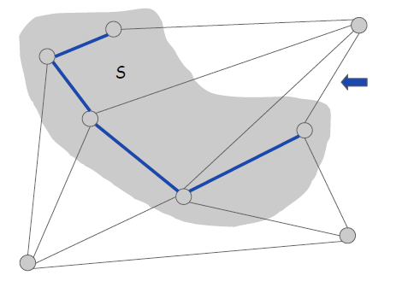
Correctness proof for Prim
Apply cut property at each step

Slide 17

Prim implementation
For each unexplored node $v$ maintain cost of cheapest way of adding it to explored set
Speed is $O\left(n^{2}\right)$ naively, $O(m\log{n})$ with priority queue

Slide 18
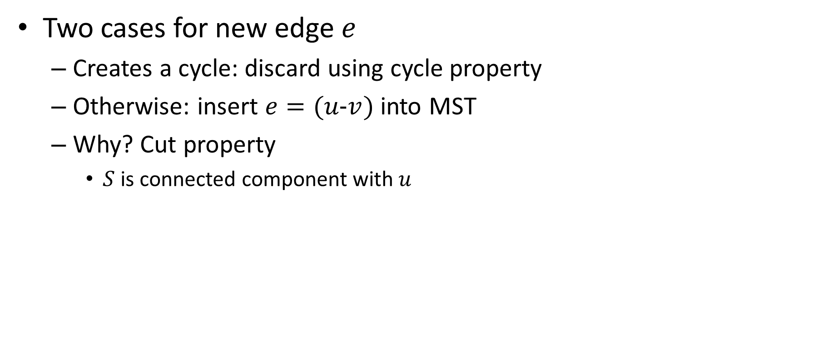
Correctness proof for Kruskal
Two cases for new edge $e$
Creates a cycle: discard using cycle property
Otherwise: insert $e=(u−v)$ into MST
Why? Cut property
$S$ is connected component with $u$

Slide 19
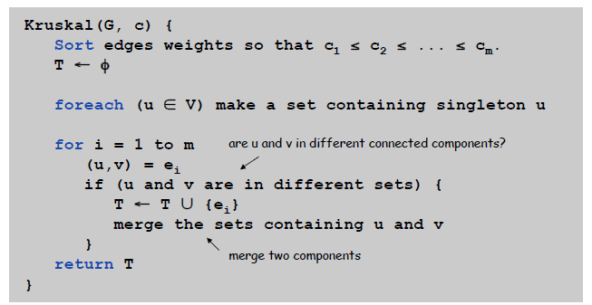
Kruskal implementation
Maintain set of edges for each connected component in MST
Use union-find to merge

Slide 20
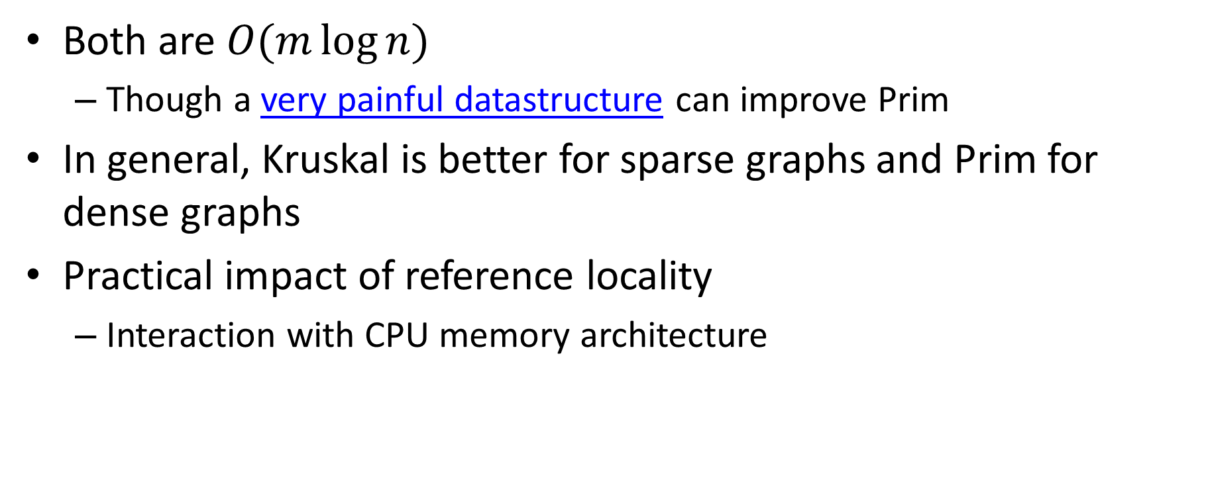
Kruskal vs Prim
Both are $O(m\log{n})$
Though a very painful datastructure can improve Prim
In general, Kruskal is better for sparse graphs and Prim for dense graphs
Practical impact of reference locality
Interaction with CPU memory architecture

